Slide 1
Version 7 Overview
PV Electronic, Lyss
10.08.2018 P.Groner

Slide 2
Fact Sheet 1
Multipurpose SMS and MMS Gateway
Legacy connection to mobile provider
Legacy connection to mobile bulk / LC provider
Customizable delivery notification (incl. Mobile Phone)
Bidirectional and action based SMS services
Customizable actions based on inbound sms
SMS inbound support for
GSM Modems (MSISDN)
Mobile Service Provider
Short ID ( 3 – 5 digits)
Long ID “Global Reply”

Slide 3
Fact Sheet 2
Non intrusive solution
No legacy connectors required (no Exchange or SAP connectors needed easy and independent upgrade Path)
Stand alone mode: No additional infrastructure required (Database, Directory)
Multinode mode: active/passive
Cluster mode: Load balancing - active/active
Backend: Shared Database and ElasticSearch

Slide 4
Fact Sheet 3
Full featured and RFC compliant interfaces
SMTP Mail
Multipart Mimetypes
HTML, Plain Text, MS-TNEF
Any type of encoded text (UTF, ISO, Windows, Mac)
End to end support for any Eastern, Western, Arabic, Indian, Asian Characters
Web based
SOAP, REST
Classic GET, POST
Native / Legacy
Telnet commands, Native binary
Database Table (send and receive sms)

Slide 5
Fact Sheet 4
Full access, account and CDR support
Integrated accounting (config files or Database)
Access control
IP-based
Domain based (source or target)
Account specific or group based
Allow / deny + regex support
Blacklist, whitelist
User/Domain based metering limits
Daily limits
Monthly limits

Slide 6
Fact Sheet 5
Security aware implementation
3 Tier architecture design
Microservice integration aware
Designed to fulfil telecom and banking rules
Configurable log files details
Limit connection relevant data (mask phone numbers by replacing last x digits)
Full encryption of messaging content as well for temporary stored content on gateway

Slide 7
Soft Facts
Software, Vender, Support 100% Switzerland
References (Selection)
On Premise Product
Nestle
SkyGuide
Mettler Toledo
Oerlikon Air Defence
Swisscom
References (UMGateway as a service – mail2sms)
AKB
Admeira
Visilab
Swisspower
Sanitas Trösch
Liftag, Wechselstube
Radio TOP
Hirslanden

Slide 8
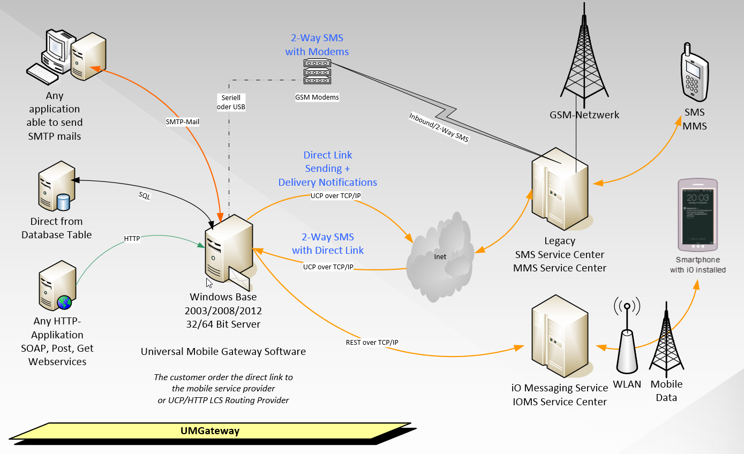
General Architecture

Slide 9
Server / Software
Native Windows Services Application
Eventlogs
Performance Counter
Control Panel Application
Registry, File or database based configurations
Windows SMTP and extensions
Automatic maintenance
Automatic alarming
Built in load balancing and clustering

Slide 10
Service Provider Support
Pager Service Provider (Swissphone)
EMI / UCP Protokoll
ALL SMS Mobile Service Provider
EMI / UCP, REST, SOAP and Native HTTP protocols
MMS Mobile Service Provider
MM7 interface, SOAP
SMS/MMS least cost routing rrovider
EMI / UCP Protokoll
Webservice protocolls (incl. customizing)
RCS and Messenger Services (Whatsapp, Fibre …)
Work in progress, Public Beta Q1/2019

Slide 11
Gateway Interfaces 1/2
Full featured smtp interface
Message content formatting
Native text decoder support for any standard or most non standard smtp implementation
Format support
Plain text, quoted printable, html, mime encoded
Multipart text, html, attachment extraction (for mms)
Ansi, ASCI, UTF-7/8, any ISO, Windows, Mac and commen eastern, south, and asian characters
Send controll code by adding options to the Subject

Slide 12
Gateway Interfaces 2/2
Native HTTP, TCP and Telnet Interface
Direct application Interfaces for senging and receiving sms or any other messages
User and Application usable Telnet commands
Read gateway state and statistics
Database Interface
Read messages direct from table, send them and update the message state in db (outbound)
Save received sms to database (inbound solutions)
SQL Cluster Aware
Support for Microsoft SQL Server 2005

Slide 13
SMS to mail reply
UMGateway support natively sms-reply function.
Adding sms inbound pool numbers. User can send out mails and the sms receiver can reply / send back the sms to be received by the original mail sender.
How to configure SMS to mail reply
Order and add at least 2 sms Global reply numbers
Add this 2 numbers, define as 2-way sms
Create and route a new mail subdomain to UMG (Example *@smsreply.yourcompany.int)
Add the new domain to the smtp service as alias
Set the new maildomain in the 2-way UMG config

Slide 14
SMS to mail reply
How to use this function
A user send a mail to sms by using the smsreply mail domain (Example: 0790009988@smsreply.yourdomain.int)
The UMGateway automatic assign the next free pool number to the sms originator.
The receiver of this sms is able to hit reply and send an sms to the pool number. This sms is now processed by UMGateway and send back to the original mailsender.
Remark
Be aware there are limitations. The number of different users can send messages to the same recipients is limited by the size of the pool. So, if the pool is 2 numbers, only 2 different users are able to send a reply’able sms to the same recipients. But one user can sent to as meny recipients as he like. All of these recipients can reply to this one user. (This is a typical example for quick requesting a response from a lot of persons – it is relativly easy to query mails in a mailbox)

Slide 15
Accounting and Billing
UMGatway support modes
File based configuration
All customer accounts, configurations and rules are saved in normal config files (like in Linux)
No restart required after changing configurations Automatic reload changed files
Full replication service for multi / cluster modes
Database based configuration
Active/active db cluster configuration
Support of any MSSQL version from 2005
Support for express editions

Slide 16
Authorisation
The access to each interface can be configured separatly
Integrated user management
3 Step access and accounting concept
Enterprise Type
Provider Type
CDR and Billing Records
Real time CSV text files
and/or database logging
ElasticSearch full index for state and log informations

Slide 17
Accounting – Database Mode
Mandanten (Domains)
Account (Login)
Multiple email addresses
Individual configuration
Credit system
Automatic daily and monthly free credits
Configuration of credit warning limit
Automatic Account
Automatic creation of first time users
Mail Domain based automatic account template (configuration and limits)
Registered Account
Individual accounting type (System, Periodic, Credit) Promote an automatic account to registerd account
Create new registered account
Individual options and limits
Provider Type
Enterprise Type

Slide 18
Accounting – Config File Rules
4 basic config files
Interface Config -> Definition of interace access
SMTP Config -> Definition of SMTP configuration
Web Config -> Definition of webservice configuration
Filter Config -> Accounting rules
Accounting Rules
Individual or domain specific gateway options
Individual or domain specific usage limits
Rule Fields: Originator, account, receiver, number, sending domain, receiving domain, subject content, body content
Allow domain specific default options and limits

Slide 19
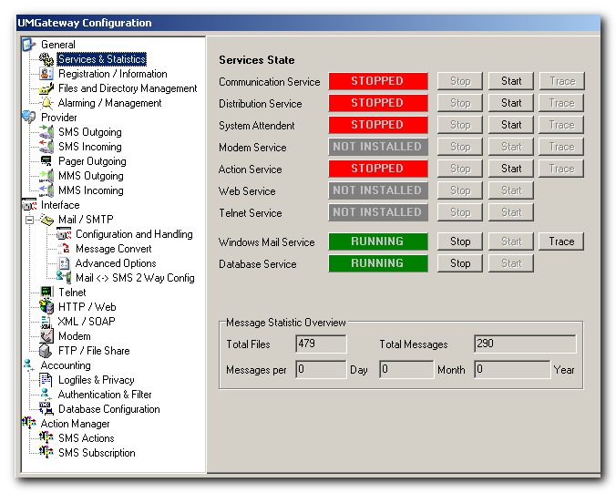
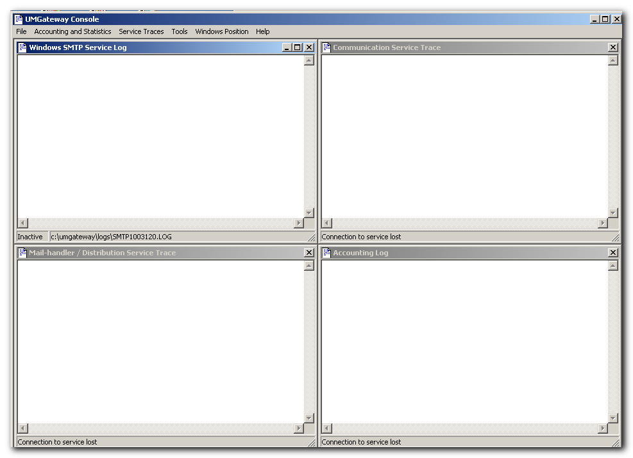
Screenshots
System Configuration and Management

Slide 20
Setup UMGateway 1
Requirements
Server with preinstalled Windows 2008 +
Relaxed security policy for first time software installation
Windows SMTP Service + Admin Tools (IIS 6)
Dotnet framework 4.5.2 +
Connectivity
Connection from and to email backend services
Appropriate server certificates
Connectivity open to mobile service provider UMG Server -> Internet to provider specific ip/tcp ports

Slide 21
Setup UMGateway 2
Software Installation
Copy the latest setup packet to the server (all installation source can be deleted after setup)
Setup automatic check system and os requirements
Run some dialogs
Setup automatic stat the configuration application
After some basic configuration and connectivity checks the service is running
We usually plan 1 working day for a complete on site setup as well the basic configuration of the product

Slide 22
More Informations
Technical Details www.umgateway.ch/documents
Software and Examples www.umgateway.ch/software
Contact Information
Produkt Info-Request: Spie, Bern
Technical Requests: sms@pve.ch

